Slide 1
Basics of Networking Mrs. Meera Ajit Khandekar Department of Instrumentation & Control College of Engineering, Pune

Slide 2
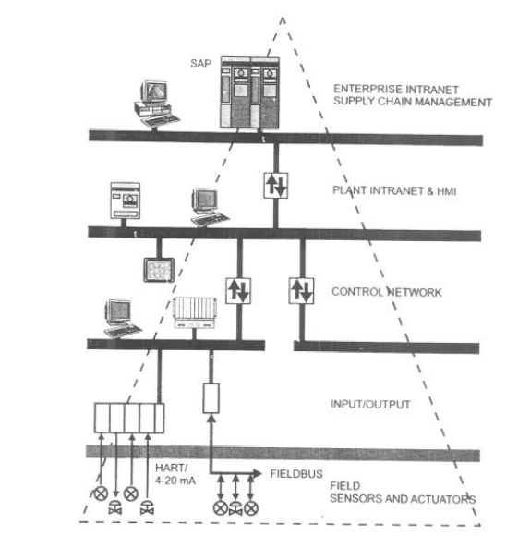
Factory Communication

Slide 3
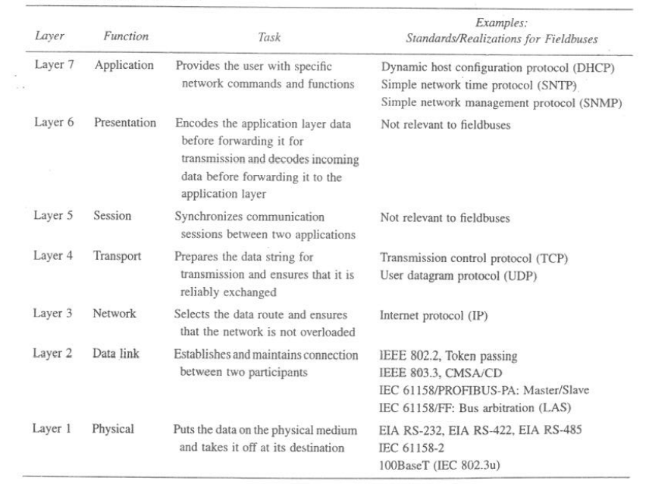
OSI Model

Slide 4
Physical layer (layer 1) : It is responsible for the actual physical connection between the devices. The physical layer contains information in the form of bits. It is responsible for transmitting individual bits from one node to the next. When receiving data, this layer will get the signal received and convert it into 0s and 1s and send them to the data link layer, which will put the frame back together.

Slide 5
The functions of the physical layer are : bit synchronization: the physical layer provides the synchronization of the bits by providing a clock. This clock controls both sender and receiver thus providing synchronization at bit level. Bit rate control: the physical layer also defines the transmission rate i.e. The number of bits sent per second. Physical topologies: physical layer specifies the way in which the different, devices/nodes are arranged in a network i.e. Bus, star, or mesh topology. Transmission mode: physical layer also defines the way in which the data flows between the two connected devices. The various transmission modes possible are simplex, half-duplex and full-duplex. * Hub, repeater, modem, cables are physical layer devices. ** Network layer, data link layer, and physical layer are also known as lower layers or hardware layers.

Slide 6
The data link layer is responsible for the node-to-node delivery of the message. The main function of this layer is to make sure data transfer is error-free from one node to another, over the physical layer. When a packet arrives in a network, it is the responsibility of DLL to transmit it to the host using its MAC address. Data link layer is divided into two sublayers: logical link control (LLC) media access control (MAC)
Data link layer (DLL) (layer 2) :

Slide 7
The functions of the data link layer are : framing: It provides a way for a sender to transmit a set of bits that are meaningful to the receiver. This can be accomplished by attaching special bit patterns to the beginning and end of the frame. Physical addressing: after creating frames, the data link layer adds physical addresses (MAC address) of the sender and/or receiver in the header of each frame. Error control: data link layer provides the mechanism of error control in which it detects and retransmits damaged or lost frames. Flow control: the data rate must be constant on both sides else the data may get corrupted thus, flow control coordinates the amount of data that can be sent before receiving acknowledgement. Access control: when a single communication channel is shared by multiple devices, the MAC sub-layer of the data link layer helps to determine which device has control over the channel at a given time. * Packet in data link layer is referred to as frame. ** Data link layer is handled by the NIC (network interface card) and device drivers of host machines. *** Switch & bridge are data link layer devices.

Slide 8
Network layer (layer 3) : Network layer works for the transmission of data from one host to the other located in different networks. It also takes care of packet routing i.e. Selection of the shortest path to transmit the packet, from the number of routes available. The sender & receiver’s IP addresses are placed in the header by the network layer. The functions of the network layer are : routing: the network layer protocols determine which route is suitable from source to destination. This function of the network layer is known as routing. Logical addressing: in order to identify each device on internetwork uniquely, the network layer defines an addressing scheme. The sender & receiver’s IP addresses are placed in the header by the network layer. Such an address distinguishes each device uniquely and universally. * Segment in network layer is referred to as packet.

Slide 9
Transport layer (layer 4) : Transport layer provides services to the application layer and takes services from the network layer. The data in the transport layer is referred to as segments. It is responsible for the end to end delivery of the complete message. The transport layer also provides the acknowledgement of the successful data transmission and re-transmits the data if an error is found. Transport layer receives the formatted data from the upper layers, performs segmentation, and also implements flow & error control to ensure proper data transmission. It also adds source and destination port numbers in its header and forwards the segmented data to the network layer. At receiver’s side: transport layer reads the port number from its header and forwards the data which it has received to the respective application. It also performs sequencing and reassembling of the segmented data.

Slide 10
Session Layer (Layer 5) : This layer is responsible for the establishment of connection, maintenance of sessions, authentication, and also ensures security. The functions of the session layer are : session establishment, maintenance, and termination: the layer allows the two processes to establish, use and terminate a connection. Synchronization: this layer allows a process to add checkpoints which are considered synchronization points into the data. These synchronization points help to identify the error so that the data is re-synchronized properly, and ends of the messages are not cut prematurely and data loss is avoided. Dialog controller: the session layer allows two systems to start communication with each other in half-duplex or full-duplex. **All the below 3 layers(including session layer) are integrated as a single layer in the TCP/IP model as “application layer”. **Implementation of these 3 layers is done by the network application itself. These are also known as upper layers or software layers.

Slide 11
Presentation Layer (Layer 6) : The presentation layer is also called the translation layer. The data from the application layer is extracted here and manipulated as per the required format to transmit over the network. The functions of the presentation layer are : translation: for example, ASCII to EBCDIC. Encryption/ decryption: data encryption translates the data into another form or code. The encrypted data is known as the ciphertext and the decrypted data is known as plain text. A key value is used for encrypting as well as decrypting data. Compression: reduces the number of bits that need to be transmitted on the network.

Slide 12
Application layer (layer 7) : At the very top of the OSI reference model stack of layers, we find the application layer which is implemented by the network applications. These applications produce the data, which has to be transferred over the network. This layer also serves as a window for the application services to access the network and for displaying the received information to the user. Ex: application – browsers, skype messenger, etc. **Application layer is also called desktop layer.

Slide 13
Repeater – A repeater operates at the physical layer. Its job is to regenerate the signal over the same network before the signal becomes too weak or corrupted so as to extend the length to which the signal can be transmitted over the same network. An important point to be noted about repeaters is that they do not amplify the signal. When the signal becomes weak, they copy the signal bit by bit and regenerate it at the original strength. It is a 2 port device. Hub – A hub is basically a multiport repeater. A hub connects multiple wires coming from different branches, for example, the connector in star topology which connects different stations. Hubs cannot filter data, so data packets are sent to all connected devices. In other words, the collision domain of all hosts connected through hub remains one. Also, they do not have the intelligence to find out the best path for data packets which leads to inefficiencies and wastage.
Network Devices

Slide 14
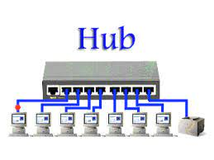
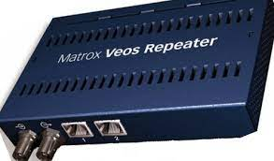

Slide 15
Bridge – A bridge operates at the data link layer. A bridge is a repeater, with add on the functionality of filtering content by reading the MAC addresses of source and destination. It is also used for interconnecting two lans working on the same protocol. It has a single input and single output port, thus making it a 2 port device. Switch –A switch is a data link layer device. The switch can perform error checking before forwarding data, which makes it very efficient as it does not forward packets that have errors and forward good packets selectively to the correct port only. Routers – A router is a device like a switch that routes data packets based on their IP addresses. The router is mainly a network layer device. Routers normally connect lans and wans together and have a dynamically updating routing table based on which they make decisions on routing the data packets. Router divide broadcast domains of hosts connected through it.
Network Devices

Slide 16
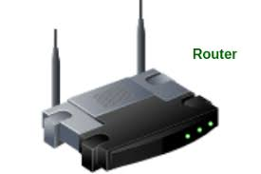

Slide 17
Gateway – A gateway, as the name suggests, is a passage to connect two networks together that may work upon different networking models. They basically work as the messenger agents that take data from one system, interpret it, and transfer it to another system. Gateways are also called protocol converters and can operate at any network layer. Gateways are generally more complex than switches or routers. NIC – NIC or network interface card is a network adapter that is used to connect the computer to the network. It is installed in the computer to establish a LAN. It has a unique id that is written on the chip, and it has a connector to connect the cable to it.

Slide 18
RS232 is an interface and the protocol between DTE(data terminal equipment) and DCE (data communication equipment) using serial binary data exchange. Here C is used for the current version. Universal asynchronous data receiver & transmitter (UART), attached in a motherboard, used in connection with RS232 for transmitting data to any serial device like modem or printer from its DTE interface. Electrical specifications : 1. Voltages: there can be two states in the signal level of RS232C pins. Mark state – it is the high bit which is represented by binary 1 and have negative voltages. Its voltage limits for transmitting signal ranges from -5 to -15V. Its voltage limits for receiving signals ranges from -3 to -25V. Space state – it is the low bit which is represented by binary 0 and have positive voltages. Its voltage limits for transmitting signal ranges from +5 to +15V. Its voltage limits for receiving signals ranges from +3 to +25V.
RS232

Slide 19
2. Cables and wires : the maximum cable length for RS232C is equals to 15.24 meters or equal to the capacitance of 2500pf. Limits for the impedance of wires ranges from 3 ohms to 7 ohms. 3 data and slew rates : rate of data transmission through RS232C is up to 20kbps. The rate of change in signal levels i.e. Slew rate is up to 30V/microsecond. 4. Current : maximum current rating is 3 amps at the maximum operating voltage of 250V AC. RS232C requires 25 pins connector for connecting DTE and DCE. Here is the list of pins and signals of RS232C and the connection between DTE and DCE using drivers and receivers.

Slide 20
TXD & RXD – Transmit Data And Receive Data On The DTE Are The Serial Data Lines. These Lines Have Opposite Functions On A DCE. TXT Sends Outgoing Data To DCE. RXD Receives Incoming Data From DTE. RTS & CTS – Transmitter Activates The Request To Send When It Requires To Transmit Data Over The Line. The Line Itself Gets Deactivated When The Communication Stops. Receiver Activates The Clear To Send To Tell The Transmitter Whether It Is Ready Or Not To Receive The Data. It Remains Active During The Transmission.

Slide 21
DTR & DSR – through the data terminal ready line, DTE informs the DCE that it is in online mode and the process of communication can occur. The main task of data set ready signal is to inform that DCE is ready for communication. DCD – DCE activates the data carrier detect in order to show that it has been connected to DTE. RI – when an incoming call on the telephone line is detected by DCE, then the ring indicator gets activates.

Slide 22
Handshaking: Before the actual data transfer, signals are transmitted from DTE to DCE in order to make connections by a process known as handshaking. Following is the sequence of signal handshaking: initially, the computer activates RTS signal to modem when a data is transferred from computer to modem. Modem in turn activates the DCD and then the CTS gets activated. Computer then sends data on TXD. After the data transmission is completed, the computer deactivates the RTS which causes the modem to deactivate CTS.

Slide 23
Applications : It is used in establishing communication between the computer and embedded systems. Due to its lower costs, it plays a vital role in CNC machines and servo controllers some microcontroller boards and PLC machines use RS232C. RS232C ports are used to communicate in headless systems in the absence of any network connection. Many computerized numerical control systems are contains RS232C port. Limitations : it cannot be used for chip to chip or chip to sensor device communication it degrades the performance of the system in the presence of noise and requires shorter cables due to having common grounds between DTE and DCE the cost of system increases as RS232C interface needs separate transceiver chips. Its performance degrades to short distances only when transfer speed is high.

Slide 24
Industrial ethernet Early ethernet systems (of the 10 mbps variety) use the CSMA/CD access method. This gives a system that operates with little delay if lightly loaded, but becomes very slow if heavily loaded. Ethernet network interface cards are relatively cheap and produced in vast quantities. However, CSMA/CD is a probabilistic medium access mechanism, there is no guarantee of message transfer and messages cannot be prioritized.

Slide 25
Modern ethernet systems are a far cry from the original design. From 100baset onwards they are capable of full duplex (sending and receiving at the same time via switches, without collisions) and the ethernet frame can be modified to make provision for prioritization and virtual LAN.

Slide 26
Ethernet technology has, however, made rapid advances over the past few years. It has gained such widespread acceptance in industry that it is becoming the de facto field bus technology for OSI layers 1 and 2. An indication of this trend is the inclusion of ethernet as the level 1 and 2 infrastructure for modbus/TCP (schneider), ethernet/IP (rockwell automation and ODVA), profinet (profibus) and foundation fieldbus HSE.

Slide 27
100 mbps ethernet one of the limitations of hub-based (CSMA/CD) 100baset systems is the size of the collision domain, which is only 250 meters or 5.12 microseconds. This is the maximum size of a network segment in which collisions can be detected, being one tenth of the maximum size of a 10 mbps network. This effectively limits the distance between a workstation and hub to 100 m, the same as for 10baset. As a result, networks larger than 200 meters must be logically interconnected by storeand-forward devices such as bridges, routers or switches.

Slide 28
This is not a bad thing, since it segregates the traffic within each collision domain, reducing the number of collisions on the network. The use of bridges and routers for traffic segregation, in this manner, is often done on industrial ethernet networks. Of course, the use of switches instead of hubs allows the construction of very large networks because of the full duplex operation. The format of the frame has been left unchanged. The only difference is that it is transmitted 10 times faster than in 10 mbps ethernet, hence its length (in time) is 10 times less.

Slide 29
TCP/IP TCP/IP is the de facto global standard for the internet (network) and host–to–host (transport) layer implementation of internet work applications because of the popularity of the internet. The internet (known as arpanet in its early years), was part of a military project commissioned by the advanced research projects agency (ARPA), later known as the defense advanced research agency or DARPA. The communications model used to construct the system is known as the ARPA model.

Slide 30
Process/application layer Host-to-host/transport layer Internet layer Network access/link layer

Slide 31
Whereas the OSI model has 7 layers, the ARPA model has 4 layers. The OSI layers map onto the ARPA model as follows. • The OSI session, presentation and applications layers are contained in the ARPA process and application layer. • The OSI transport layer maps onto the ARPA host–to–host layer (sometimes referred to as the service layer). • The OSI network layer maps onto the ARPA internet layer. • The OSI physical and data link layers map onto the ARPA network interface layer.

Slide 32
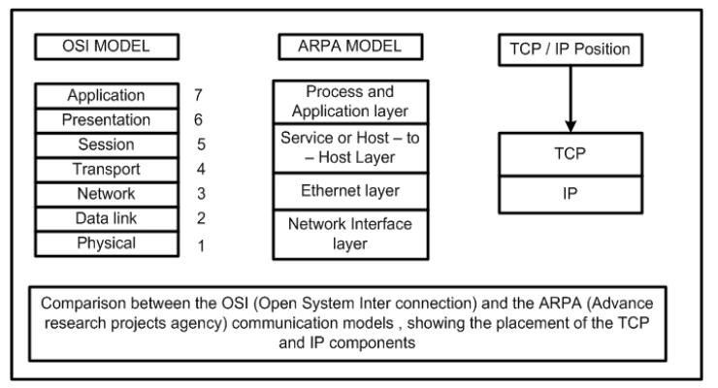
OSI vs. ARPA models

Slide 33
1. Network access layer – It is combination of data link layer and physical layer of the OSI model. It looks out for hardware addressing and the protocols present in this layer allows for the physical transmission of data. 2. Internet layer – this layer parallels the functions of osi’s network layer. It defines the protocols which are responsible for logical transmission of data over the entire network. The main protocols residing at this layer are : IP – stands for internet protocol and it is responsible for delivering packets from the source host to the destination host by looking at the IP addresses in the packet headers. IP has 2 versions:ipv4 and ipv6. Ipv4 is the one that most of the websites are using currently. But ipv6 is growing as the number of ipv4 addresses are limited in number when compared to the number of users.

Slide 34
ICMP – stands for internet control message protocol. It is encapsulated within IP datagrams and is responsible for providing hosts with information about network problems. ARP – stands for address resolution protocol. Its job is to find the hardware address of a host from a known IP address. ARP has several types: reverse ARP, proxy ARP, gratuitous ARP and inverse ARP.

Slide 35
3. Host-to-host layer – this layer is analogous to the transport layer of the OSI model. It is responsible for end-to-end communication and error-free delivery of data. It shields the upper-layer applications from the complexities of data. The two main protocols present in this layer are : transmission control protocol (TCP) – it is known to provide reliable and error-free communication between end systems. It performs sequencing and segmentation of data. It also has acknowledgment feature and controls the flow of the data through flow control mechanism. User datagram protocol (UDP) – on the other hand does not provide any such features. It is the go-to protocol if your application does not require reliable transport as it is very cost-effective. Unlike TCP, which is connection-oriented protocol, UDP is connectionless.

Slide 36
4. Application Layer – This layer performs the functions of top three layers of the OSI model: application, presentation and session layer. It is responsible for node-to-node communication and controls user-interface specifications. Some of the protocols present in this layer are: HTTP, HTTPS, FTP, TFTP, telnet, SSH, SMTP, SNMP, NTP, DNS, DHCP, NFS, X window, LPD. Protocols other than those present in the linked article are : HTTP and HTTPS – HTTP stands for hypertext transfer protocol. It is used by the world wide web to manage communications between web browsers and servers. HTTPS stands for http-secure.

Slide 37
SSH – SSH stands for secure shell. It is a terminal emulations software similar to telnet. The reason SSH is more preferred is because of its ability to maintain the encrypted connection. It sets up a secure session over a TCP/IP connection. NTP – NTP stands for network time protocol. It is used to synchronize the clocks on our computer to one standard time source. It is very useful in situations like bank transactions. Assume the following situation without the presence of NTP. Suppose you carry out a transaction, where your computer reads the time at 2:30 PM while the server records it at 2:28 PM. The server can crash very badly if it’s out of sync.

Slide 38
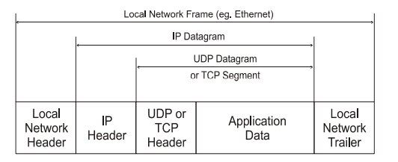
Internet frame

Slide 39
Thank you!!!

